Slide 1
Data Analyst Job Tracker
Based on 20K jobs scraped from Linkedin

Slide 2




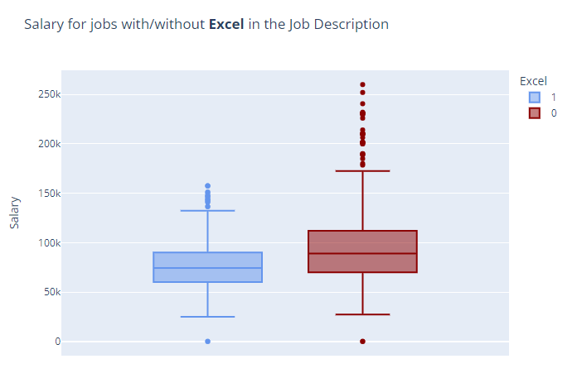
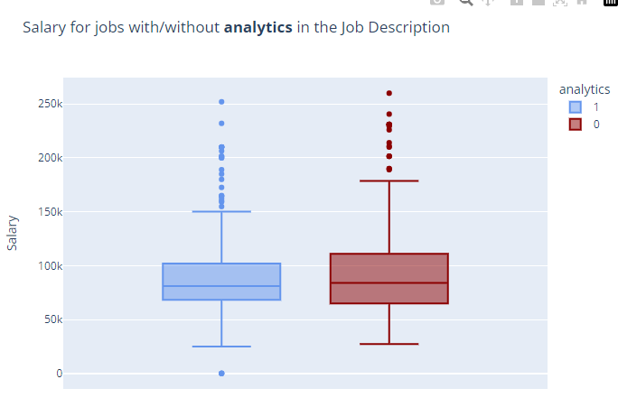
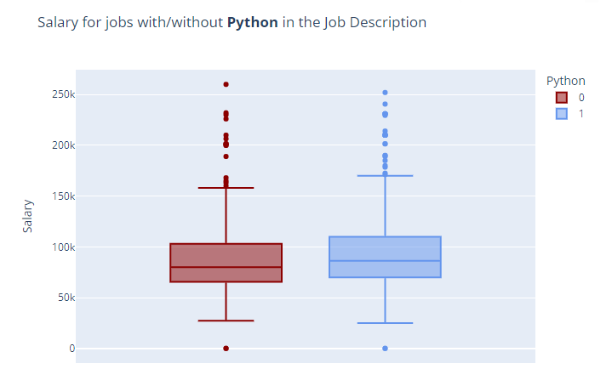
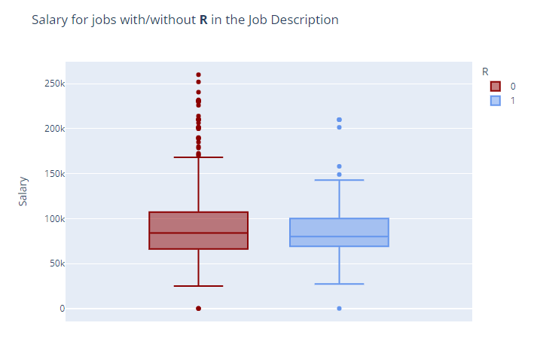
How skills affect salary

Slide 3
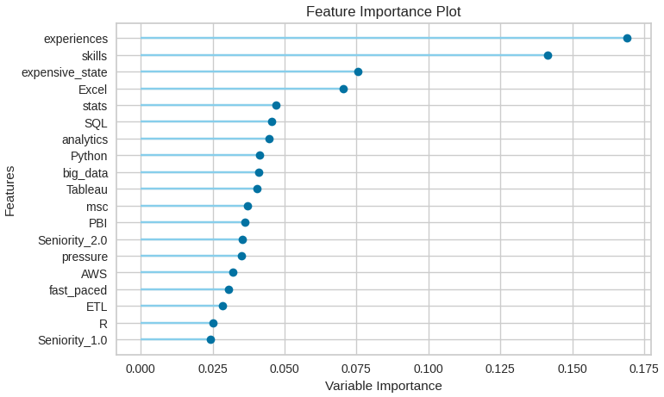
Feature Engineering
Experiences: number of times the word “Experience” shows up in the job description
Skills: number of skills identified through Entity Recognition: Python, R, SQL, AWS, etc.
Expensive_state: whether job was located in “Expensive states”: Oregon, Washington, California,
According to how many % of the jobs in the state were above the threshold of $90.000
For expensive states, 47% of the jobs were above vs. 25% for “not-expensive” states
Most Relevant skills: Excel, SQL, Python
Mentions of “Analytics”, “Big Data”, and “Statistics”

Slide 4
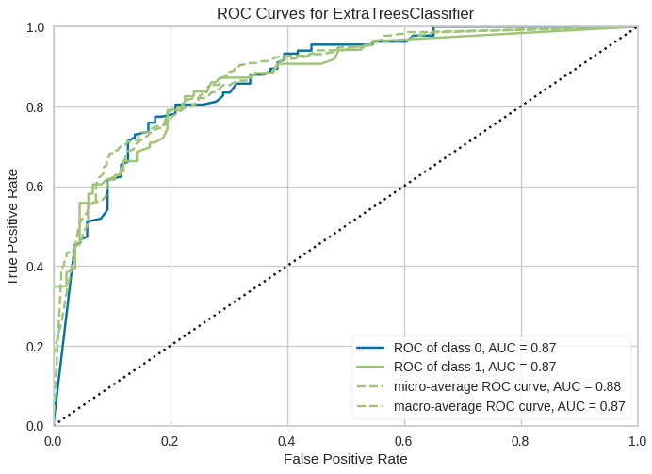
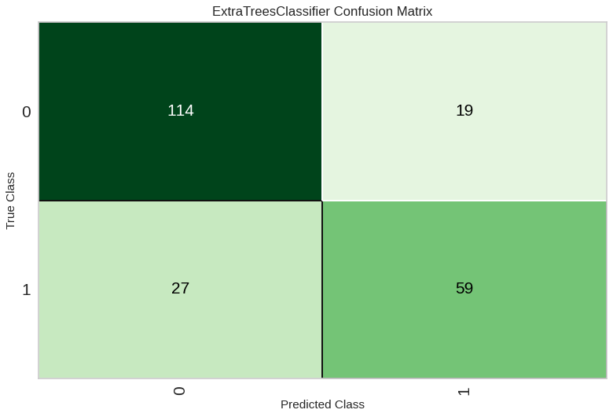
Model results
Bad results with Regression -> instead, could we predict whether a particular job has a salary of $90.000 or more?
Results: yeah, more often than not, actually!

Slide 5
Next steps
Improve Feature Engineering (geographical attributes, count of ocurrences of important words)

